Slide 1
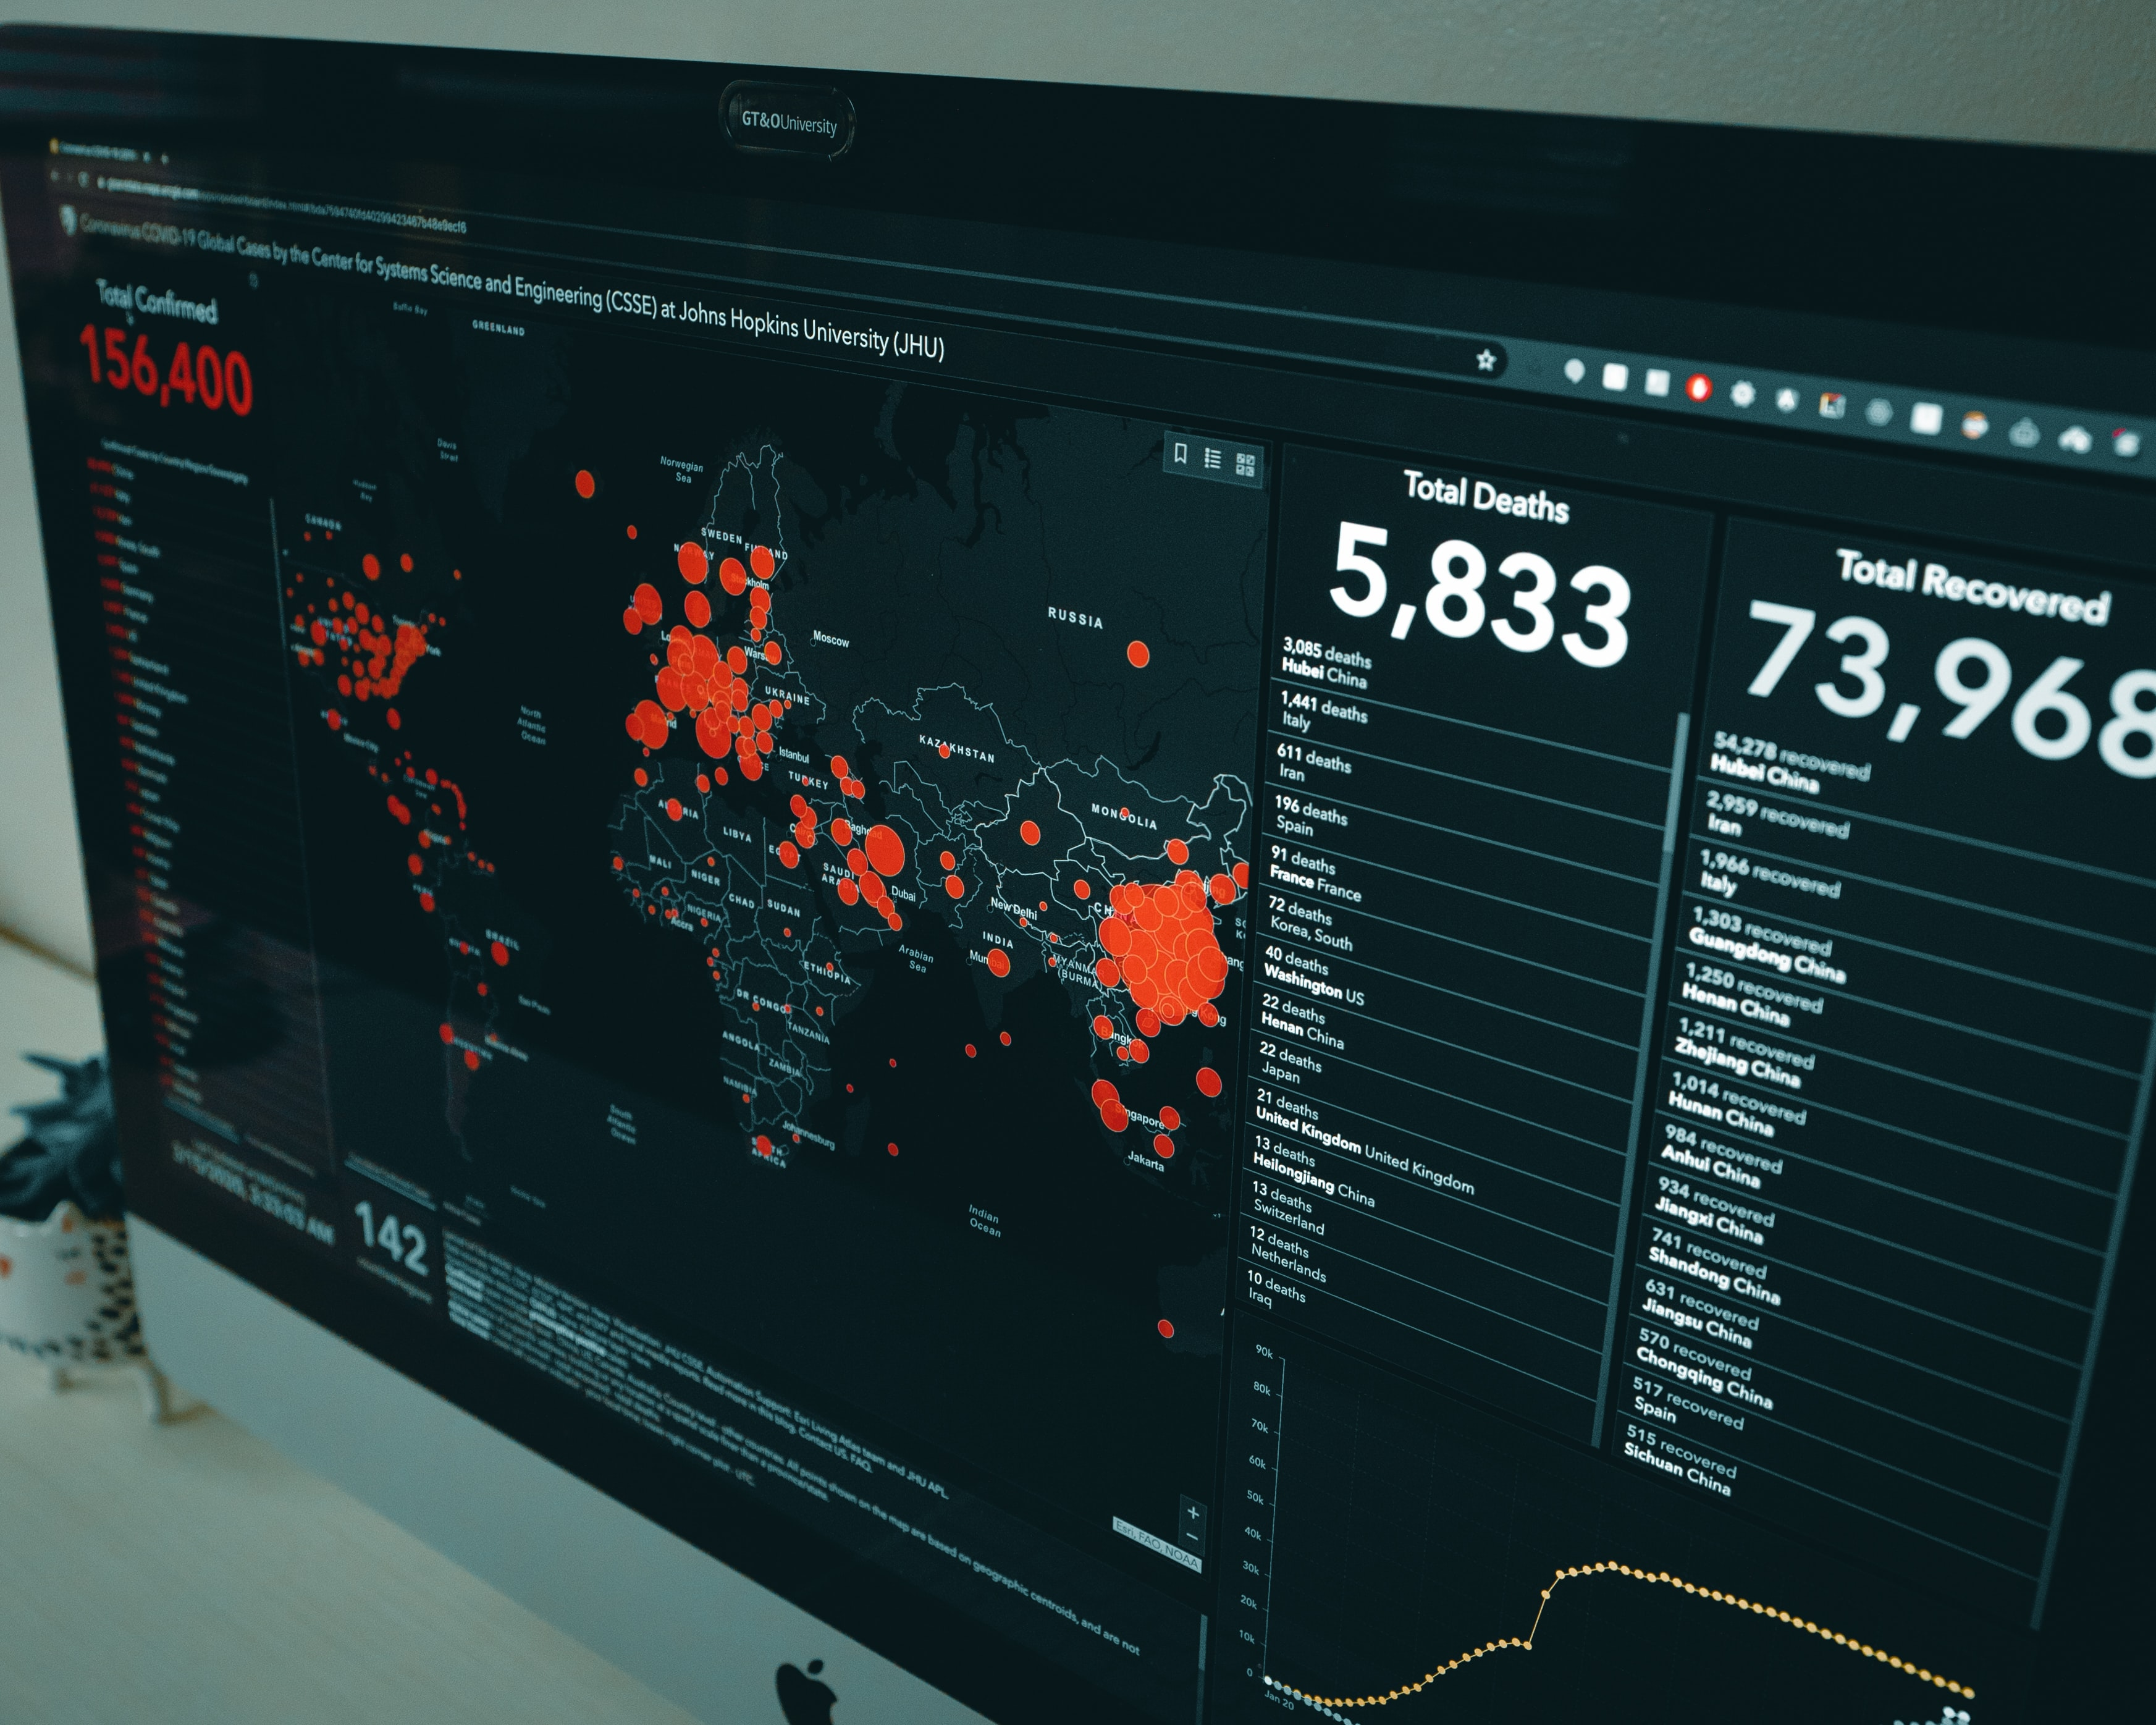
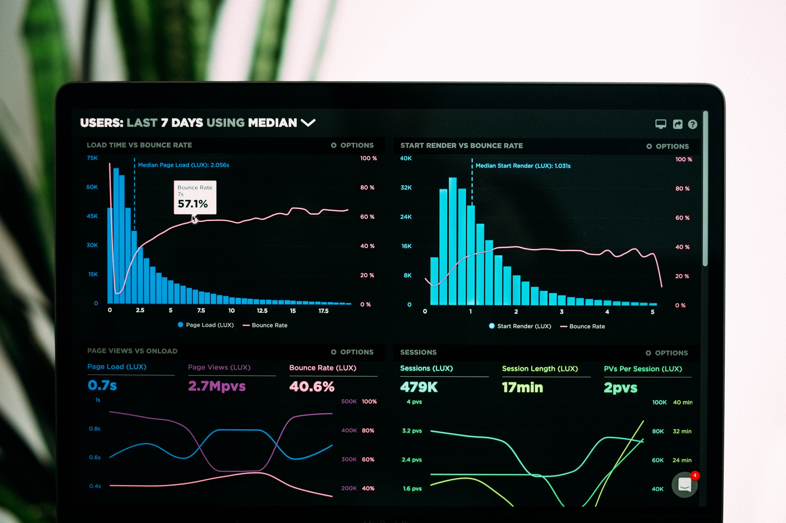

Tableau Project On Global Superstore
By - Ashish Chaudhary

Slide 2
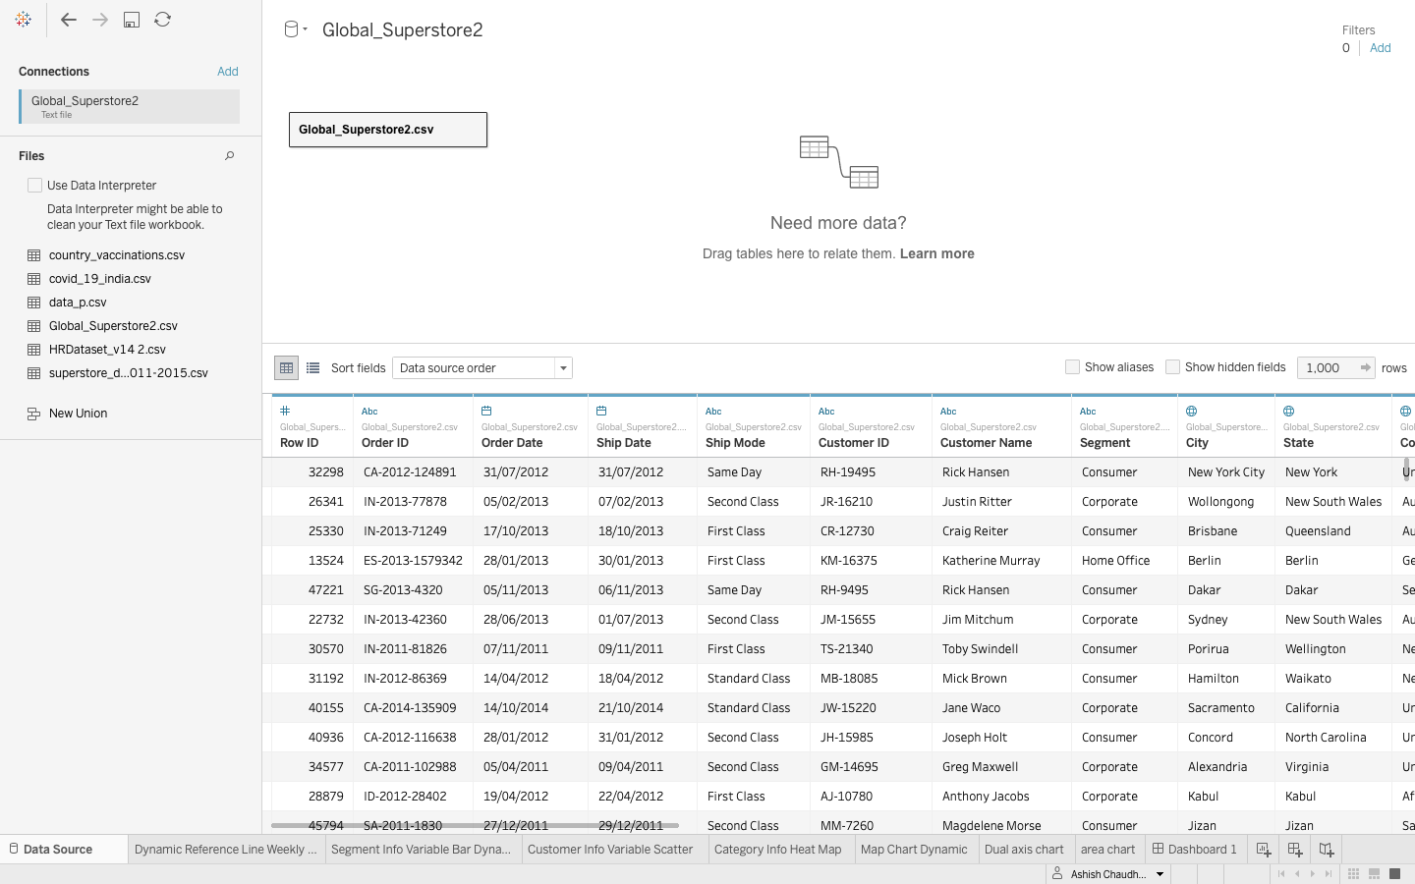
Data Source
Data Source :
The Dataset I have used in this project has been taken from kaggle. This data set has 24 Columns And 51291 Rows
Each Row Represents 1 customer transaction with all valuable transaction
We have order id of the product,Order date, ship date in which product is shipped, ship mode wheather it is through first, second or standard class,Unique customer id,Customer name,Segment
Wheather the order is placed by consumer, corporate or home office, city from which order is placed,State from which order is placed, Country ,postal code, Market, Region, product id, category, sub-category, product name ,sales,Quantity,Discount,Profit,Shipping cost And Order priority.

Slide 3
Problem Statements And Steps
Shopping online is currently the need of the hour. Because of this COVID, it's not easy to walk in a store randomly and buy anything you want. I this I am trying to understand a few things like
Customers Analysis
Profile the customers based on their frequency of purchase - calculate frequency of purchase for each customer
Do the high frequent customers are contributing more revenue
Are they also profitable - what is the profit margin across the buckets
Which customer segment is most profitable in each year.
How the customers are distributed across the countries-
With this superstore dataset I have to Analyse the sales, profit, quantity of product and discount w.r.t Country/state and cities of the various type of product ordered by different type of segment.

Slide 4
Product Analysis
Which country has top sales?
Which are the top 5 profit-making product types on a yearly basis
How is the product price varying with sales - Is there any increase in sales with the decrease in price at a day level
What is the average delivery time across the counties - bar plot

Slide 5
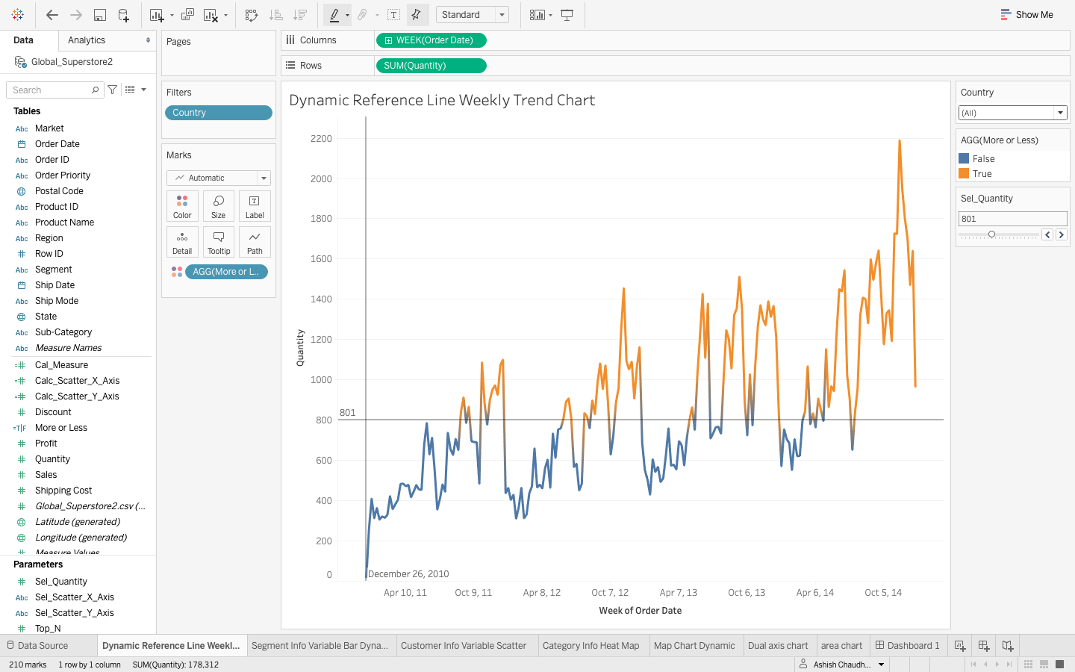
Line Chart Of Quantity vs Order date.In this I have used a parameter named Sel_Quantity which act as reference line according to which we can tell wheather the sales went good or bad.Alongwith that I have used a filter of country.

Slide 6
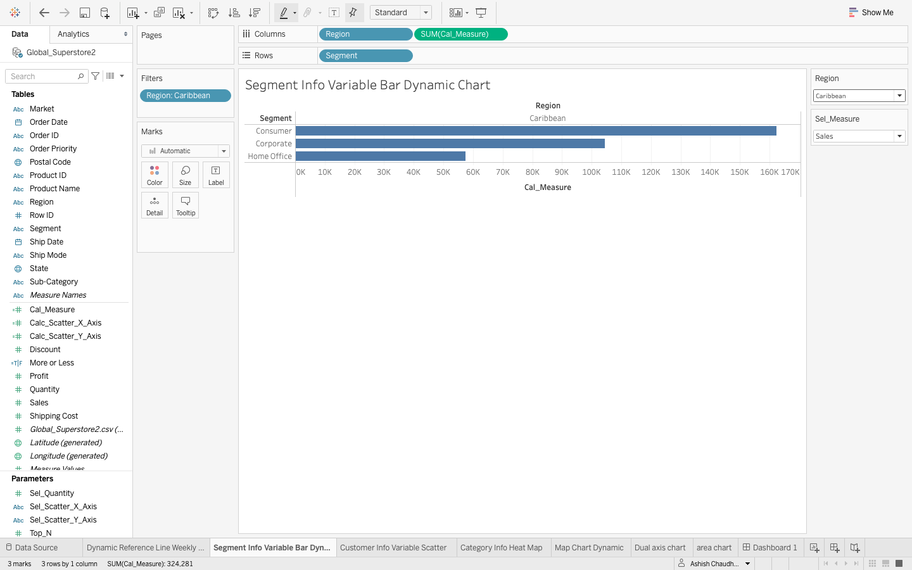
Segment info bar chart in this I have used filter on region and also I have created as parameter names sel_measure which tell about sales, profit, discount and quantity with respect to Segment.

Slide 7
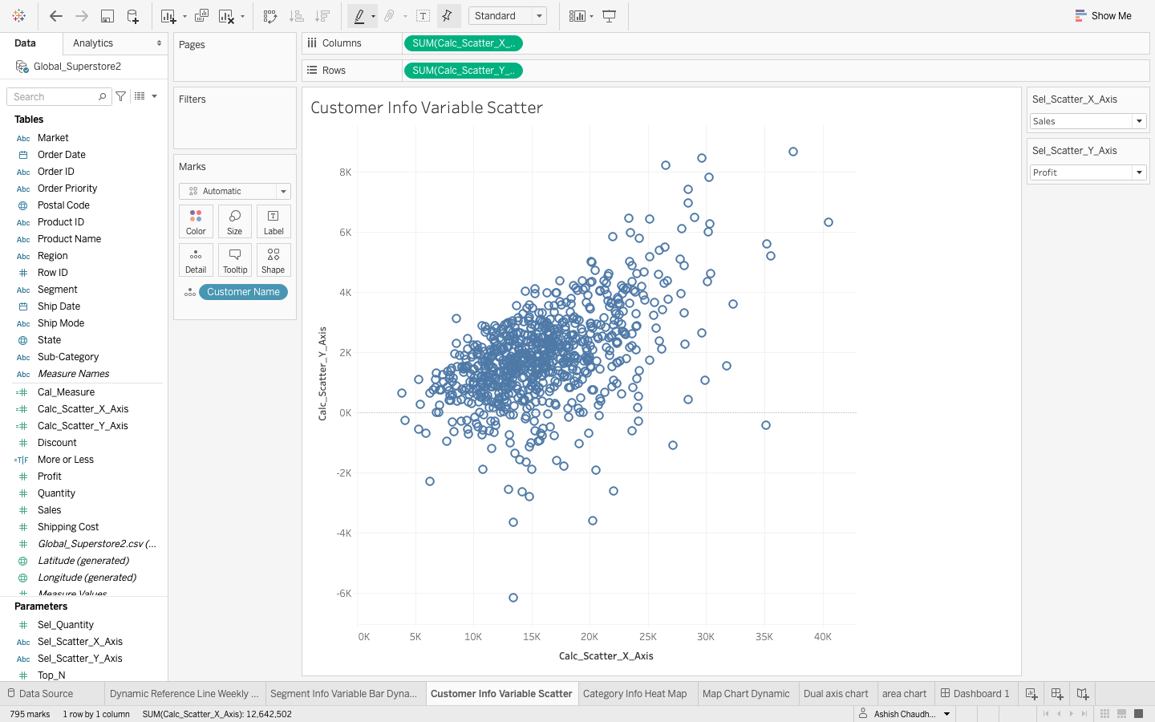
Customer info variable scatter plot in this plot I have created two parameter for x and y axis it tells about the sale, discount, quantity and profit w.r.t x and y axis and also I have added customer name into detail mark type to show the customer names on the plot.

Slide 8
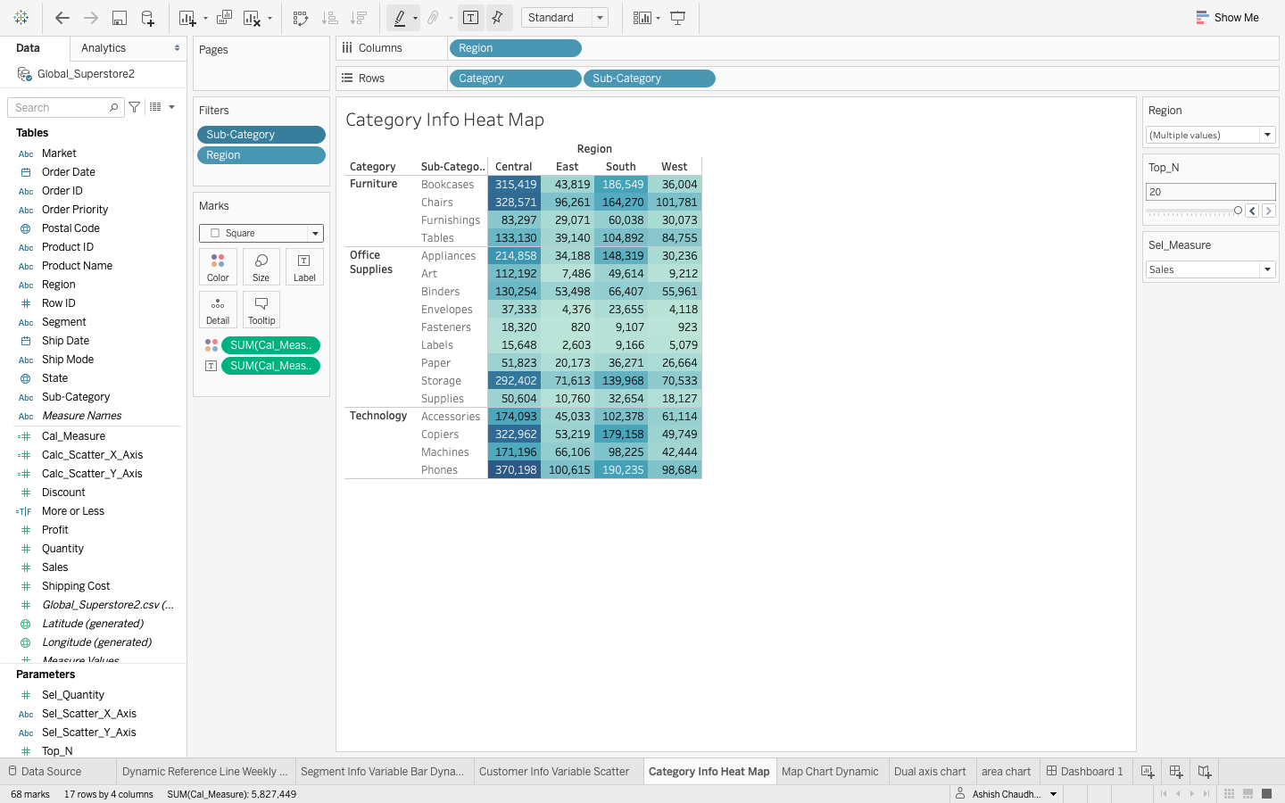
Category sub-category info Heat map chart in this chart I have created a filter on region and created a parameter name sel_measure which give the values of sale, quantity, profit and discount w.r.t category and sub-category also I have created another parameter for top_N measures.

Slide 9
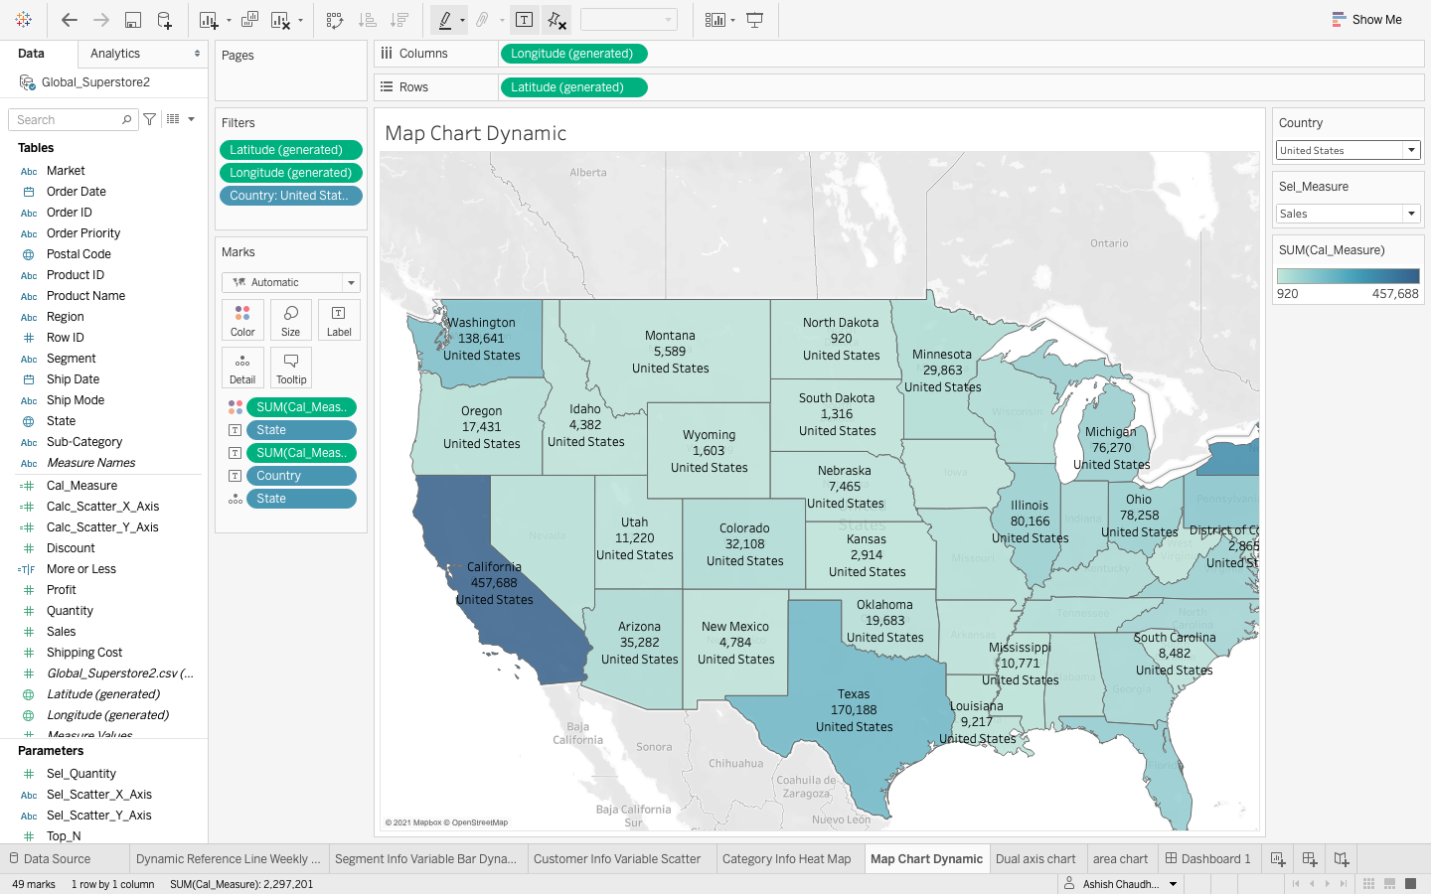
Map Chart here I have created a filter on country name and also I have created a parameter for sel_measures which tell about the sale, profit, quantity and discount w.r.t state and country.

Slide 10
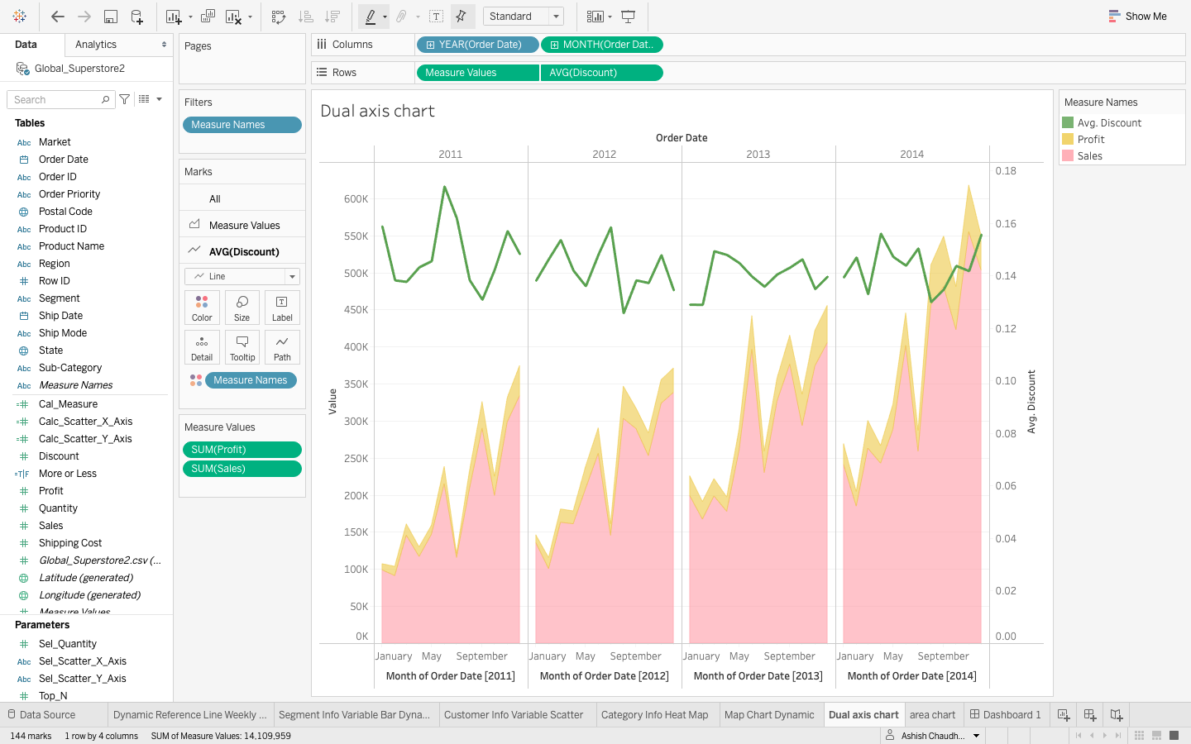
Dual axis chart here I have created a dual axis chart based on Avg. discount, profit and sales.

Slide 11
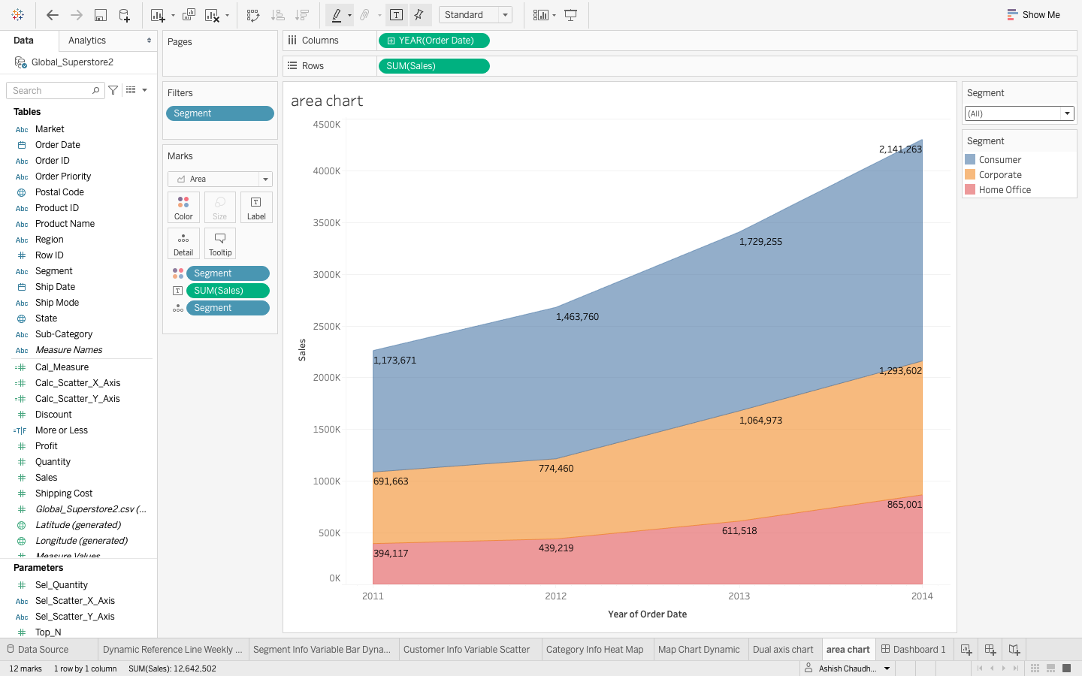
Area chart this chart tell about the sales based on different segment w.r.t order date.

Slide 12
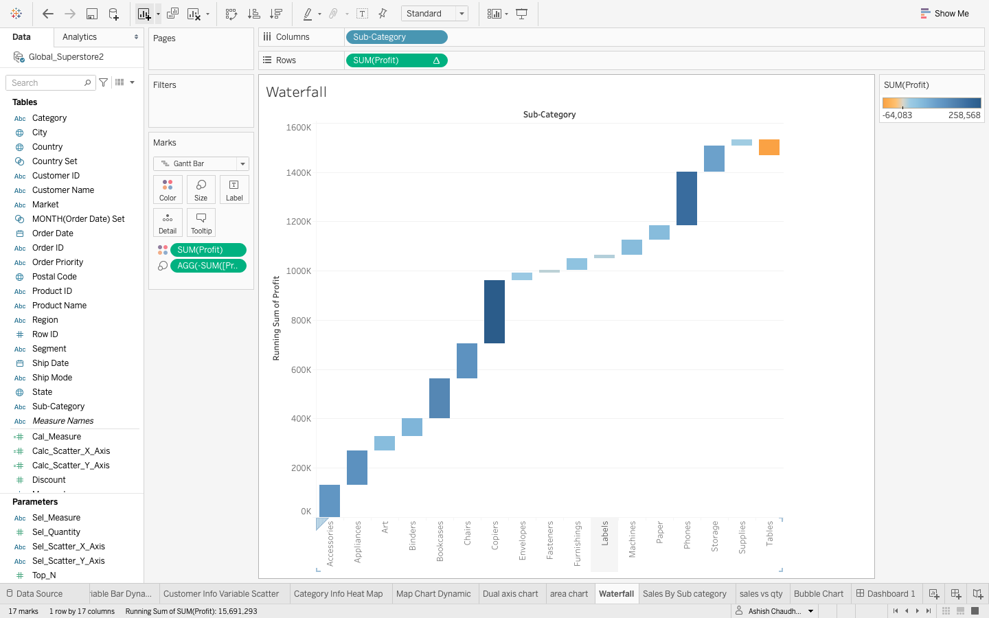
Waterfall chart this chart tell about the profit w.r.t Sub-category.

Slide 13
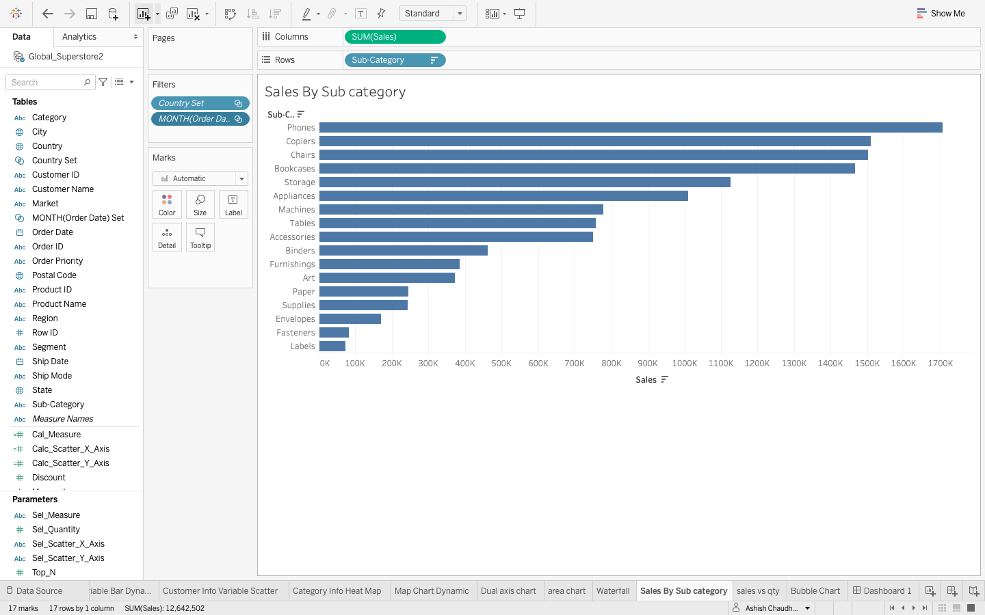
Sales by sub-category bar chart this chart tell about the total sales w.r.t sub-category for e.g in this top selling product is phones.

Slide 14
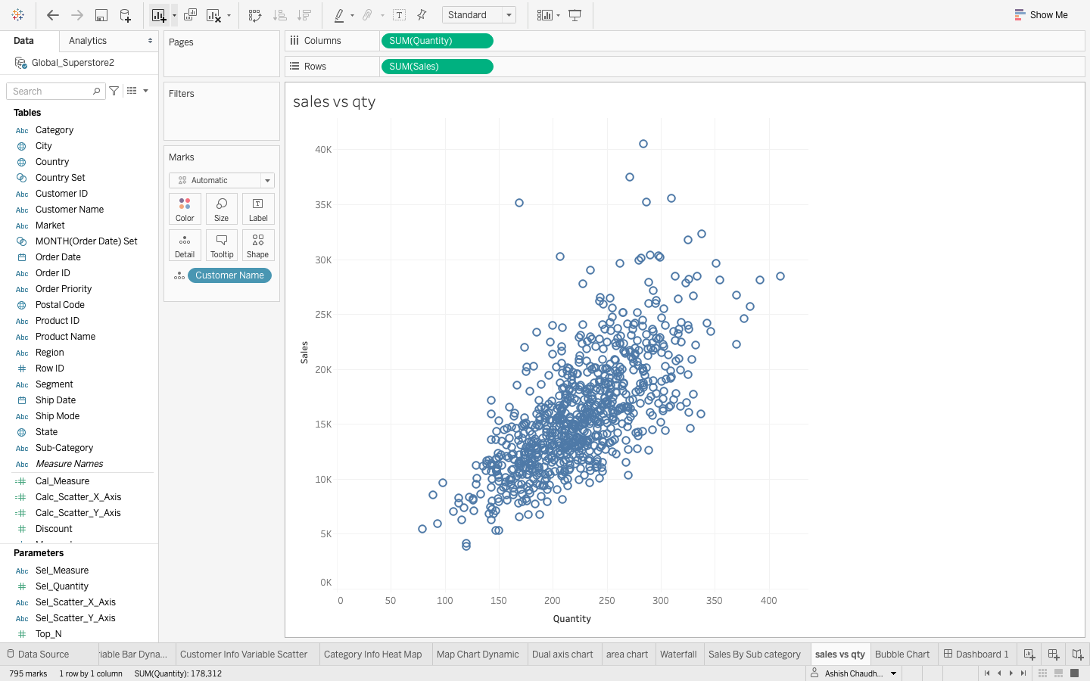
Sales vs Quantity Scatter plot in this plot it tells about the quantity vs sales of the product.In this I have used customer name in detail mark type.

Slide 15
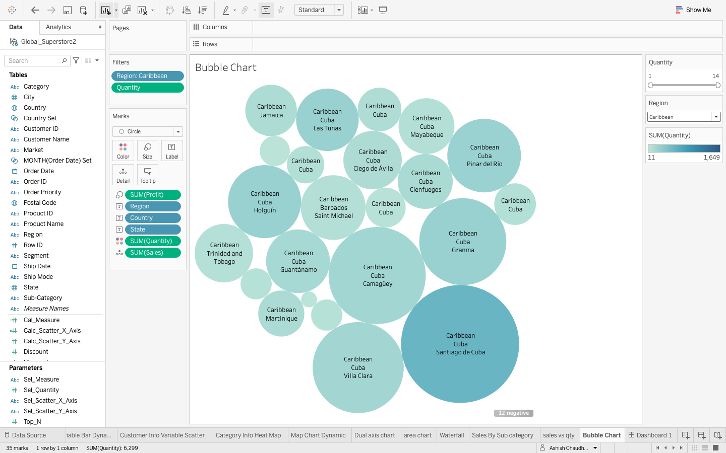
Bubble chart this chart tell about the Quantity of the product sold w.r.t region.i have used region as filter.For e.g in this chart Caribbean/cuba has maximum number of quantity sold.

Slide 16
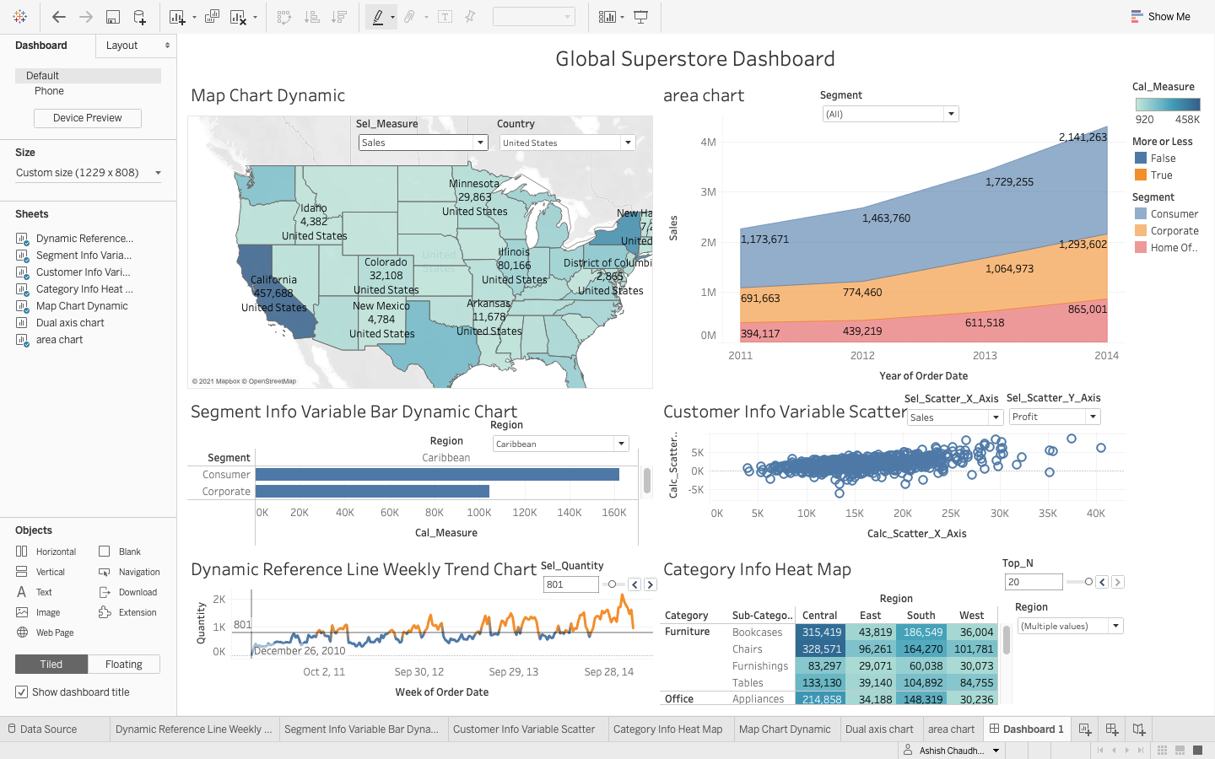
Tableau Dashboard

Slide 17
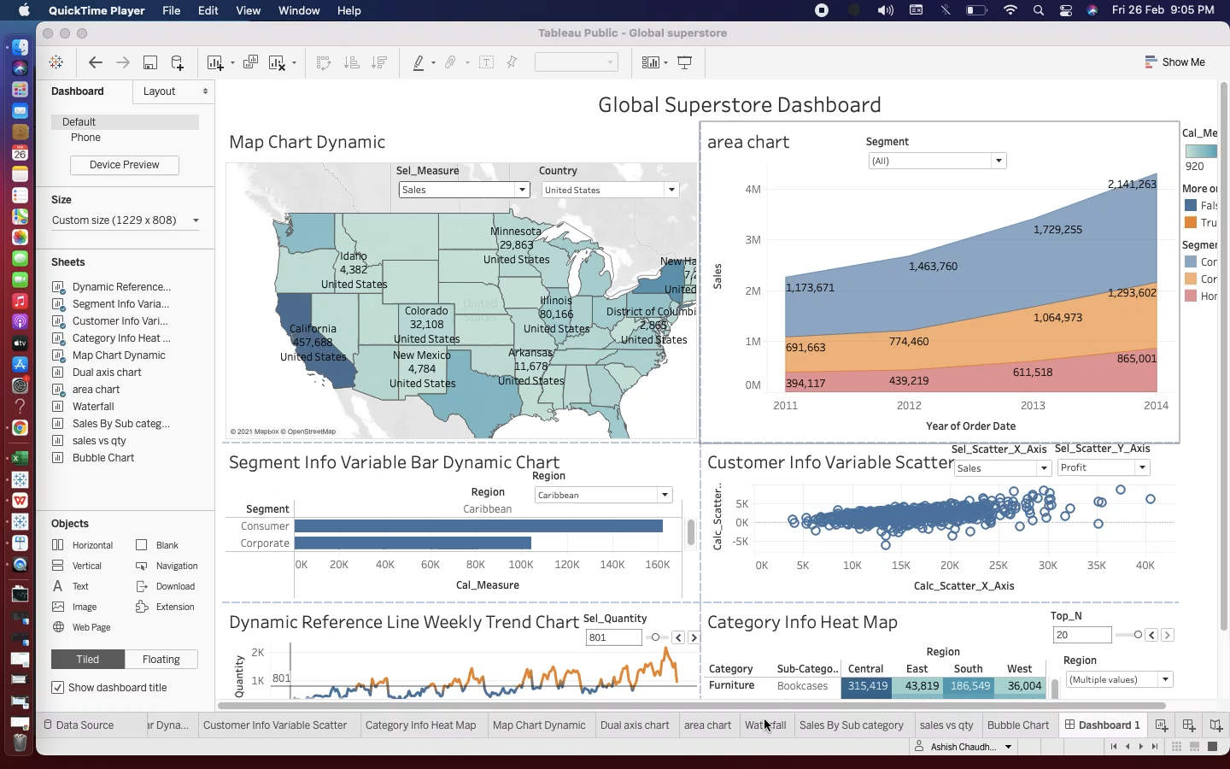

Slide 18
Conclusion
This Global superstore dataset analysis helped me to analyse the sales, profit, discount and number of quantity ordered from the superstore from different part of the countries.
With the help of trend line chart I have visualised the number of quantity sold w.r.t weekly.
With the help of bar chart I have visualised sales, profit and discount of product w.r.t segment.
With the help of scatter plot I have visualised the sales, profit, discount and quantity w.r.t x and y axis.
With the help of heat map I have visualised Top 20 sales, profit and discount w.r.t category and sub-category.
With the help of map chart I have visualised the sales, quantity, discount and profit w.r.t Country / state and city.
With the help of dual axis chart I have visualised the sales, profit and avg. discount w.r.t months.
With the help of area chart I have visualised total sales based on the segment.
With waterfall chart I have visualised profit w.r.t sub-category.
With the help of bar chart I have visualised top selling product which in this case is phones.
With the help of sales vs quantity scatter plot I have visualised sales w.r.t quantity.
With the help of bubble chart I have visualised maximum number of quantity sold w.r.t Region.

Slide 19
Video Link
Tableau project video presentation
https://youtu.be/aUOUoSjnWJw

Slide 20
THANK YOU

